Slide 1
Statistics with Spa ows
Lecture 6
Julia Schroeder
Julia.schroeder@imperial.ac.uk

Slide 2
Outline
Influence of df on test
Hypothesis testing

Slide 3

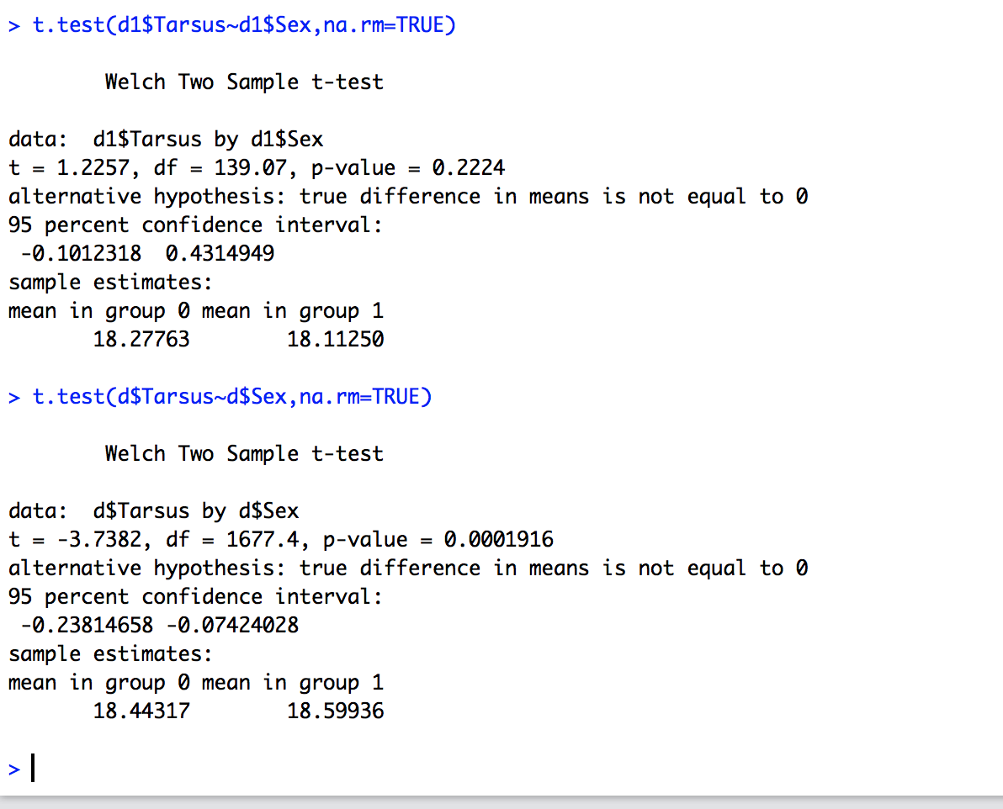
Influence of df on t-test:

Slide 4
Influence of df on t-test:

Slide 5
Influence of df (n) on t-test:

Slide 6
Wait, what?
Let’s digress for a moment…

Slide 8
What does this mean?
What is real and what is an illusion?
Decision errors

Slide 9
H0 | Reality | Illusion
rejected | Effect detected Effect exists | Type I error Effect detected, but does not exist
accepted | No effect detected No effect exists | Type II error No effect detected, but it exists

Slide 10
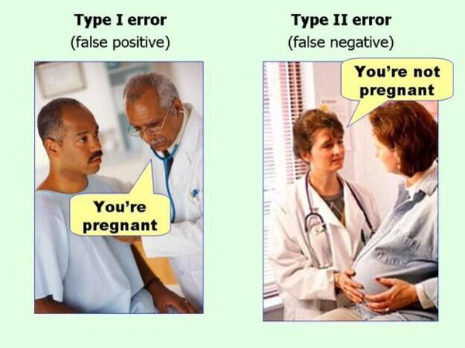

Slide 12
0.05
5% chance of detecting an effect that does not exist

Slide 13
Type II effects depend on statistical power
The bigger the sample size, the smaller the chance for type II errors
0.05
5% chance of detecting an effect that does not exist

Slide 14
Influence of df on t-test:

Slide 15
Influence of df on t-test:
Difference of 0.5mm!
Biological relevance?

Slide 16
Statistical power
Probability to detect an effect of specific size
What effect size do you need?
What effect size is biological meaningful?

Slide 17
Statistical power
To calculate statistical power you need
Mean in each group (make one 0, the other difference. 0.16)
N (sample size – we want to find that one out)
Sd of combined groups 0.96
Power level (usually 80% is ok)

Slide 18
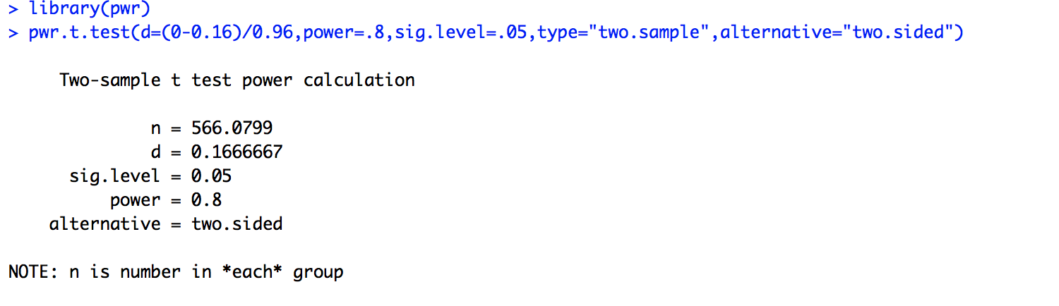
Statistical power
To calculate statistical power you need
Mean in each group (make one 0, the other difference. 0.16)
N (sample size – we want to find that one out)
Sd of combined groups 0.96
Power level (usually 80% is ok = type II error chance 20%)

Slide 19
Statistical power
To calculate statistical power you need
Mean in each group (make one 0, the other difference. 0.16)
N (sample size – we want to find that one out)
Sd of combined groups 1
Power level (usually 80% is ok = type II error chance 20%)

Slide 20
DO IT NOW – no handout!
Download package “pwr”
Run a power analysis to find out how large a sample of wing length data must be to detect a difference of an effect size of 5mm!

Slide 21
DO IT NOW – no handout!
Download package “pwr”
Run a power analysis to find out how large a sample of wing length data must be to detect a difference of an effect size of 5mm!
effect size d = effect size you want to detect (differnce between two meant) = 5/sd

